Slide 1
Project 3: Bitcoin’s Price Correlation with the Stock Market & BTC Price Prediction
done BY: Janet mushava

Slide 2

Analyzing the evolution of Bitcoin’s price correlation with the stock market over time
Part 1: Use Sentiment Analysis to see the sentiments expressed about Bitcoin in news headlines, social media, and other texts
Part 2: BTC performance analysis with the market to see if correlation has changed over time and create a portfolio simulation with a recommendation
Part 3: Stock Prediction- build an algorithmic trading bot to create trading signals for BTC

Slide 3
Part 1: Has there been a change in how Bitcoin’s price moves with the market? If so, why?
Before 2020, crypto assets such as Bitcoin and Ethereum showed little correlation with major stock indices. They were thought to help diversify risk and act as a hedge against swings in other asset classes and inflation.
Lately, Bitcoin’s correlation with stocks has turned higher than that between stocks and other assets such as gold and investment grade bonds.
Since 2020, sentiment in crypto and equity markets indicate a growing interconnectedness between the two asset classes that could destabilize financial markets.
An explanation for this could be the fact that central banks flooded markets with liquidity in 2020 when the pandemic happened and increased money supply much quicker than in the past.
Another reason is because Bitcoin has always been considered inflation-proof and could therefore be a hedge against rising inflation. However, its extreme volatility and growing correlation with the stocks threatens this theory.

Slide 4
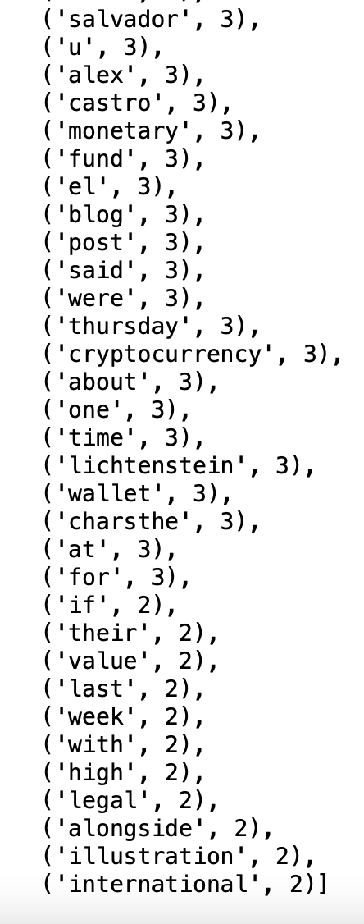
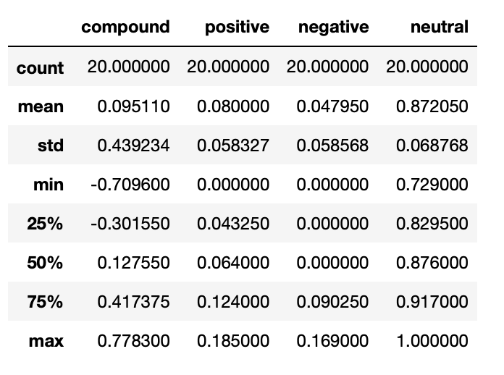
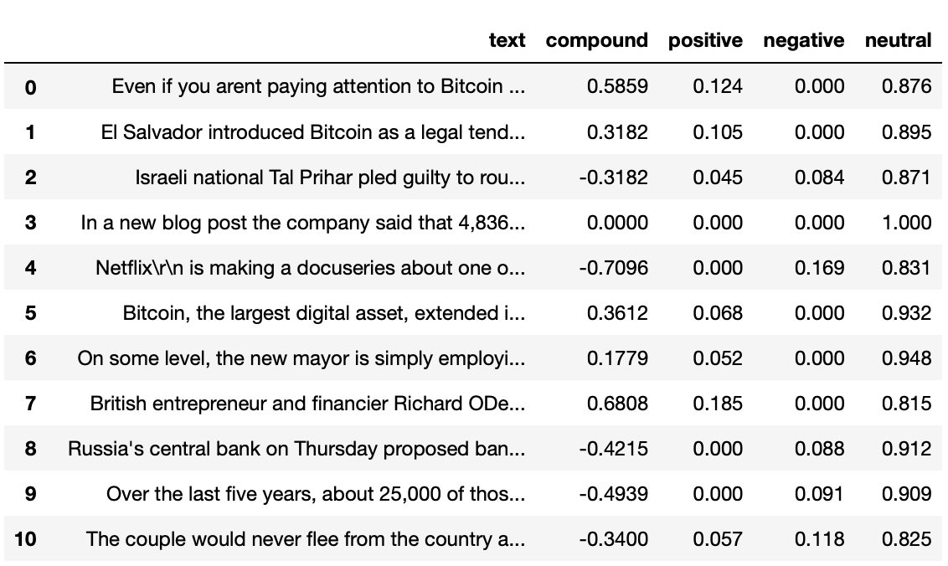
Use Sentiment Analysis to see the sentiments expressed about Bitcoin in news headlines, social media, and other texts.
Top Words
BTC Sentiment Scores

Slide 5
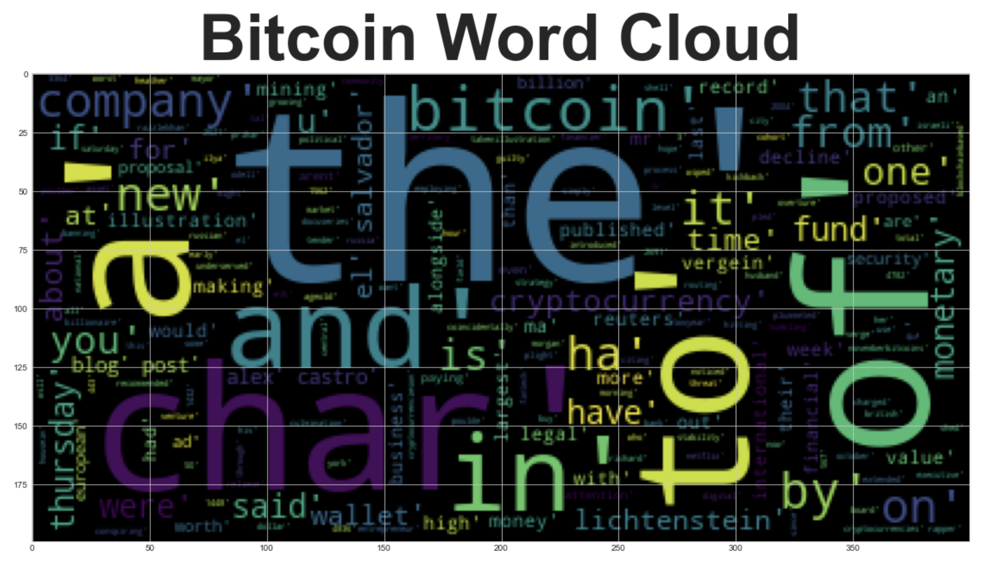

Slide 6
Part 2: BTC performance analysis with the market to see if correlation has changed over time
SPY (Overall)- Chose SPY as a benchmark to see how the overall market performed
BTC (Crypto Currency)- Chose BTC as the benchmark crypto
ETH (Crypto Currency)- Chose ETC to see if it follows BTC or if it’s an anomaly
XRP (Crypto Currency)- Chose XRP to see if it follows BTC or if it’s an anomaly

Slide 7
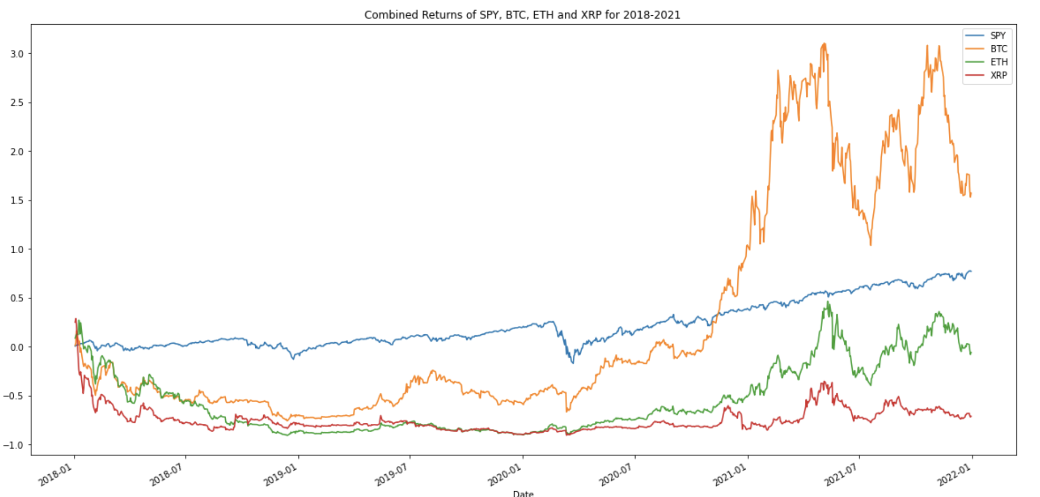
Quantitative Analysis
From 2018 to 2019, we see that BTC, ETH and XRP move more closely together while SPY follows its own path. But in 2020, we see BTC breakaway from its pattern with the other cryptocurrencies and become more strongly correlated with SPY.
Combined Returns of SPY, BTC, ETH and XRP

Slide 8
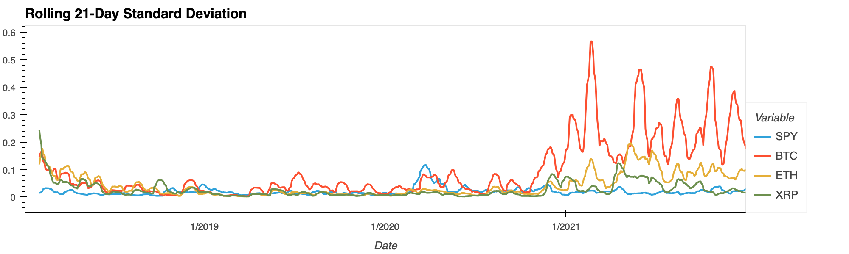
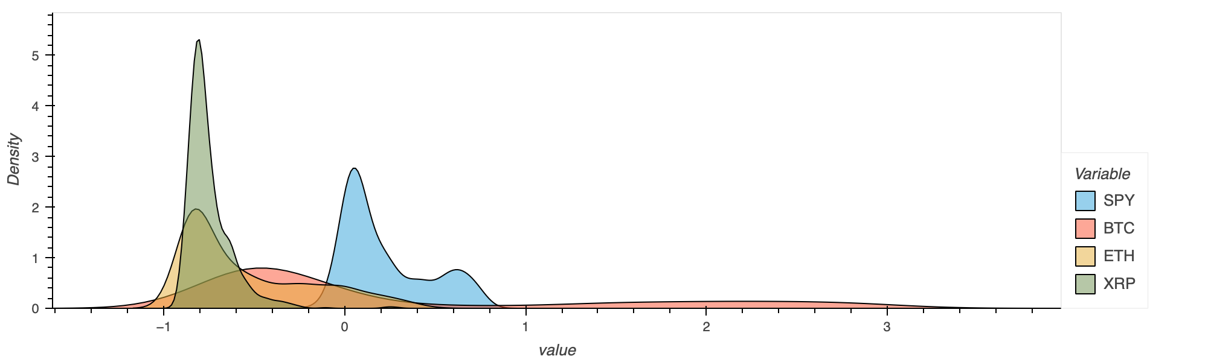
Quantitative Analysis
Standard Deviation: BTC has a higher standard deviation than SPY, ETH and XRP making it the most volatile.
Rolling 21-Day Standard Deviation Plot
Density Plot
Volatility: With the widest distribution, we see that BTC is the most volatile indicating that it has the highest risk

Slide 9
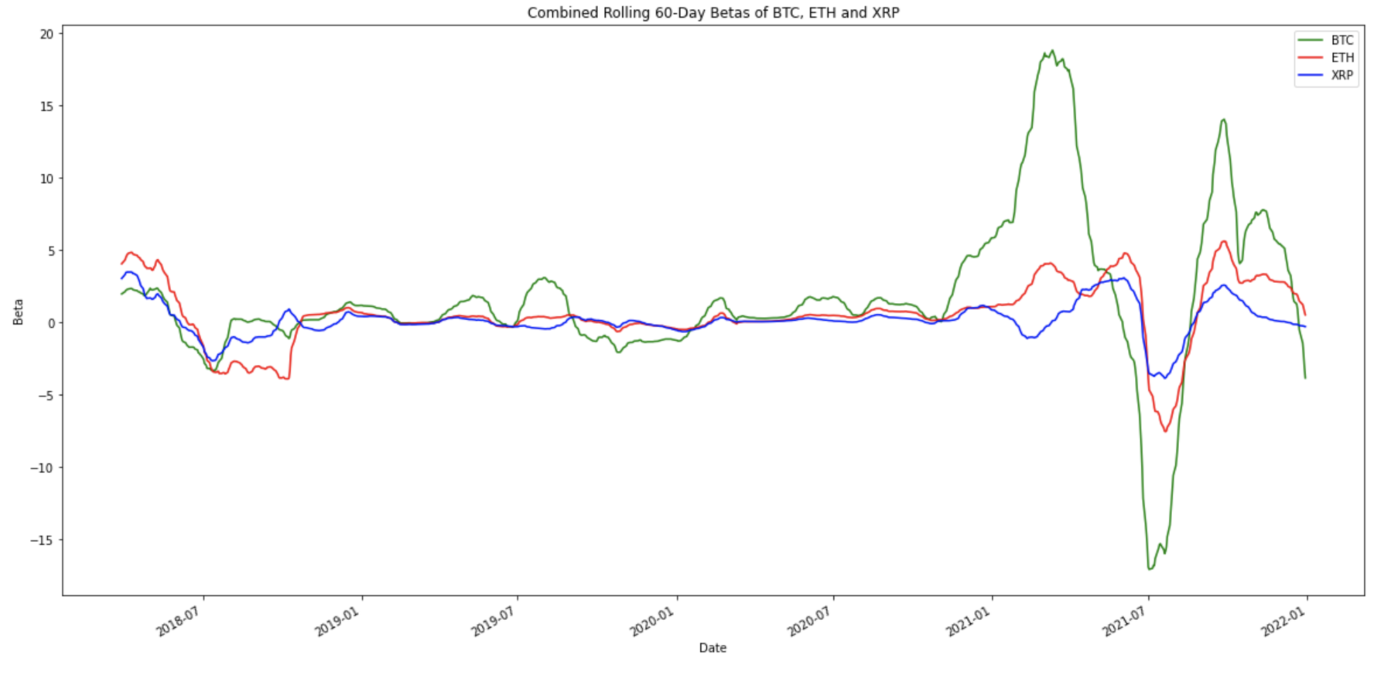
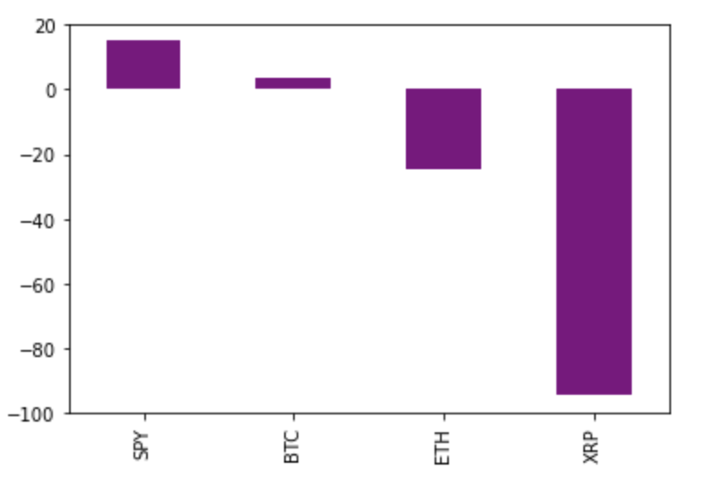
Quantitative Analysis
Sharpe Ratio Plot
Combined Rolling 60-Day Betas of BTC, ETH and XRP
Sharpe Ratio: SPY gives the highest return for every unit of risk assumed by the investor while ETH and XRP give a negative return for every unit of risk assumed.
Beta: BTC has the highest beta which indicates that BTC’s price tends to be a lot more volatile than the market. If we want a diversified portfolio, we need to add stocks that have less correlation and less volatility with the overall market.

Slide 10
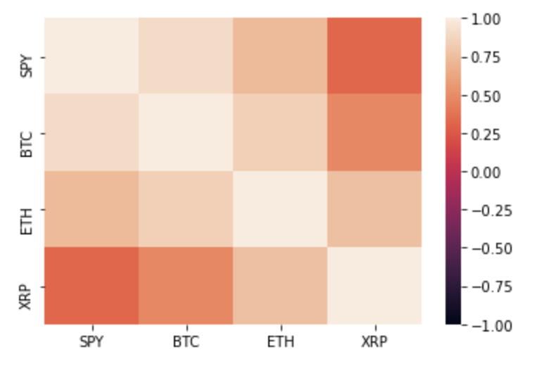
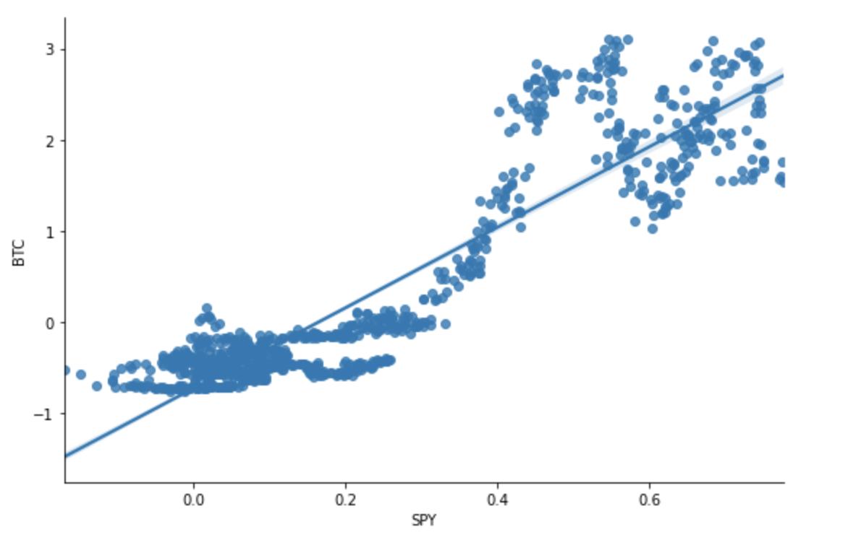
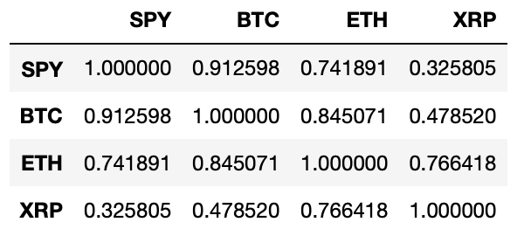
Correlation Heatmap
Correlation: BTC and SPY are not perfectly correlated so correlation does not imply causation. However, they are very highly correlated which suggests a strong relationship.
Beta vs. Correlation scatterplot
Correlation Mix

Slide 11
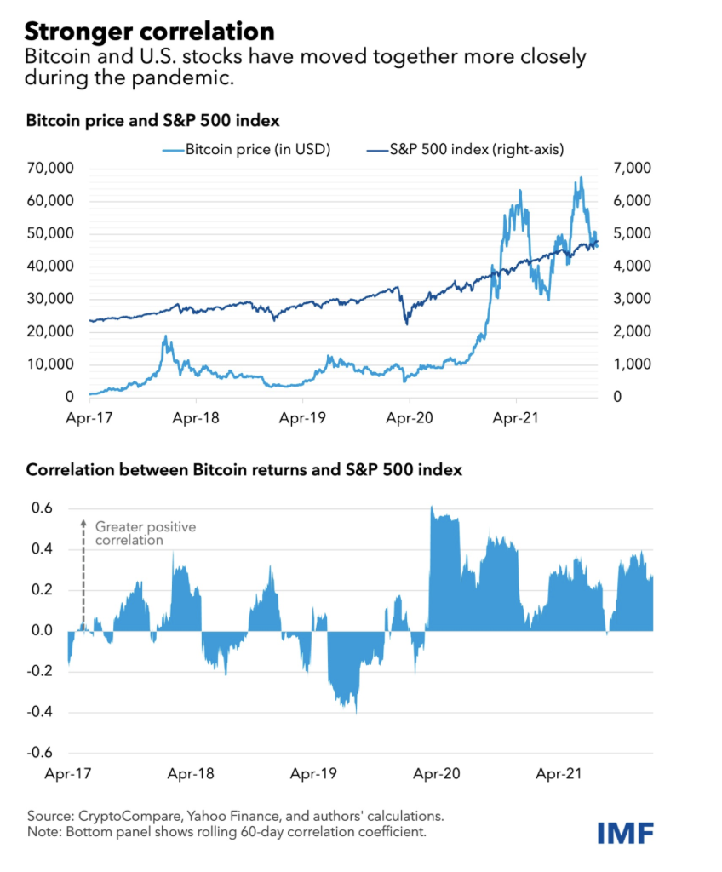
Quantitative Analysis

Slide 12
Part 2: Based on the performance analysis of BTC, create a portfolio simulation
Investor profile
Risk tolerance- medium
Age- 45
Time horizon- 20 years
Asset type- cryptocurrency
Investment amount- $300,000
Because the investor is optimistic about the market, create a long-position algorithm

Slide 13
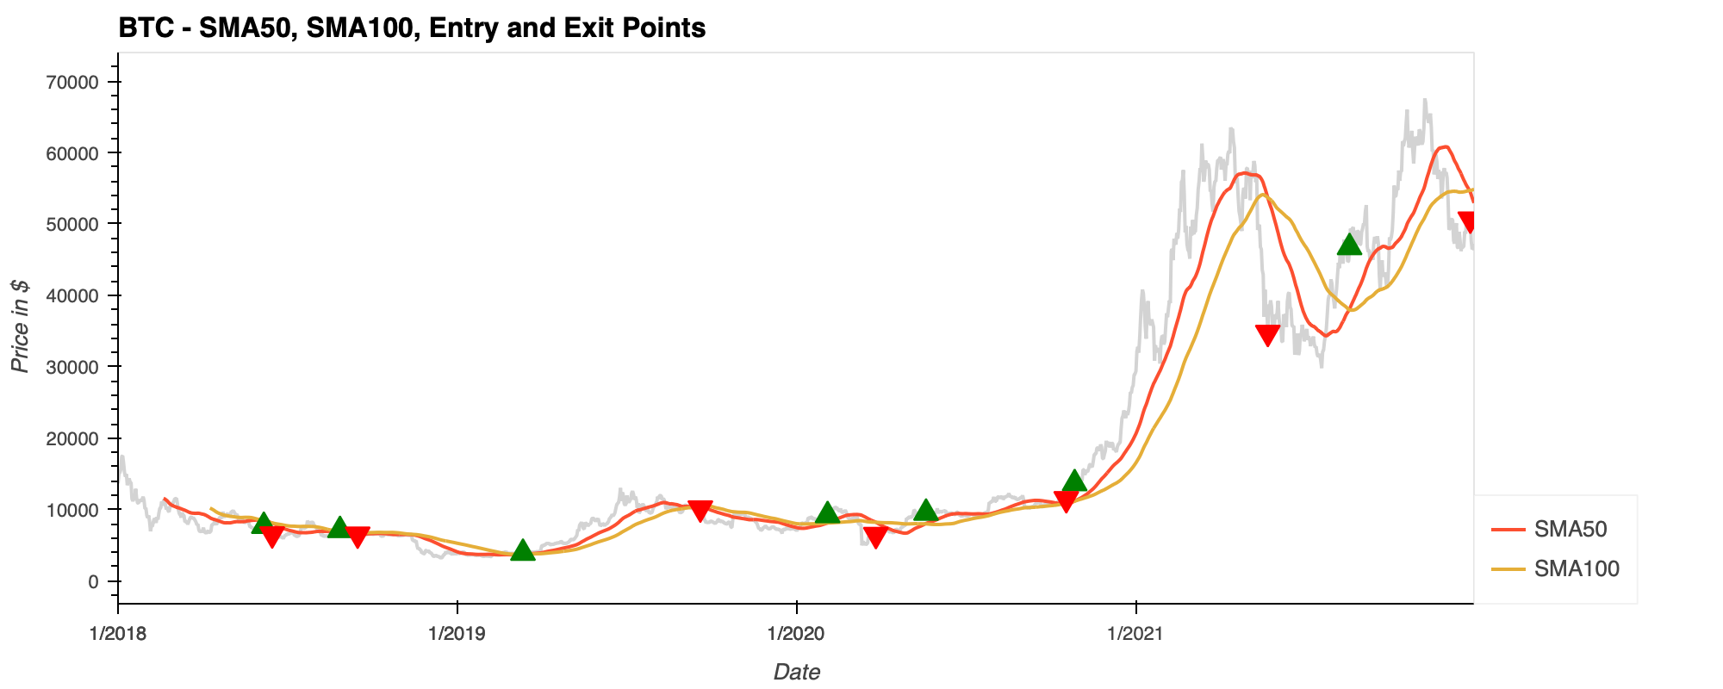
Long-Position Algorithm
A trade was entered when the “SMA50” value crossed above the “SMA100” value, and the trade was exited when the “SMA50” value crossed below the “SMA100” value.
The investor makes a profit using the “buy low, sell high” strategy.

Slide 14
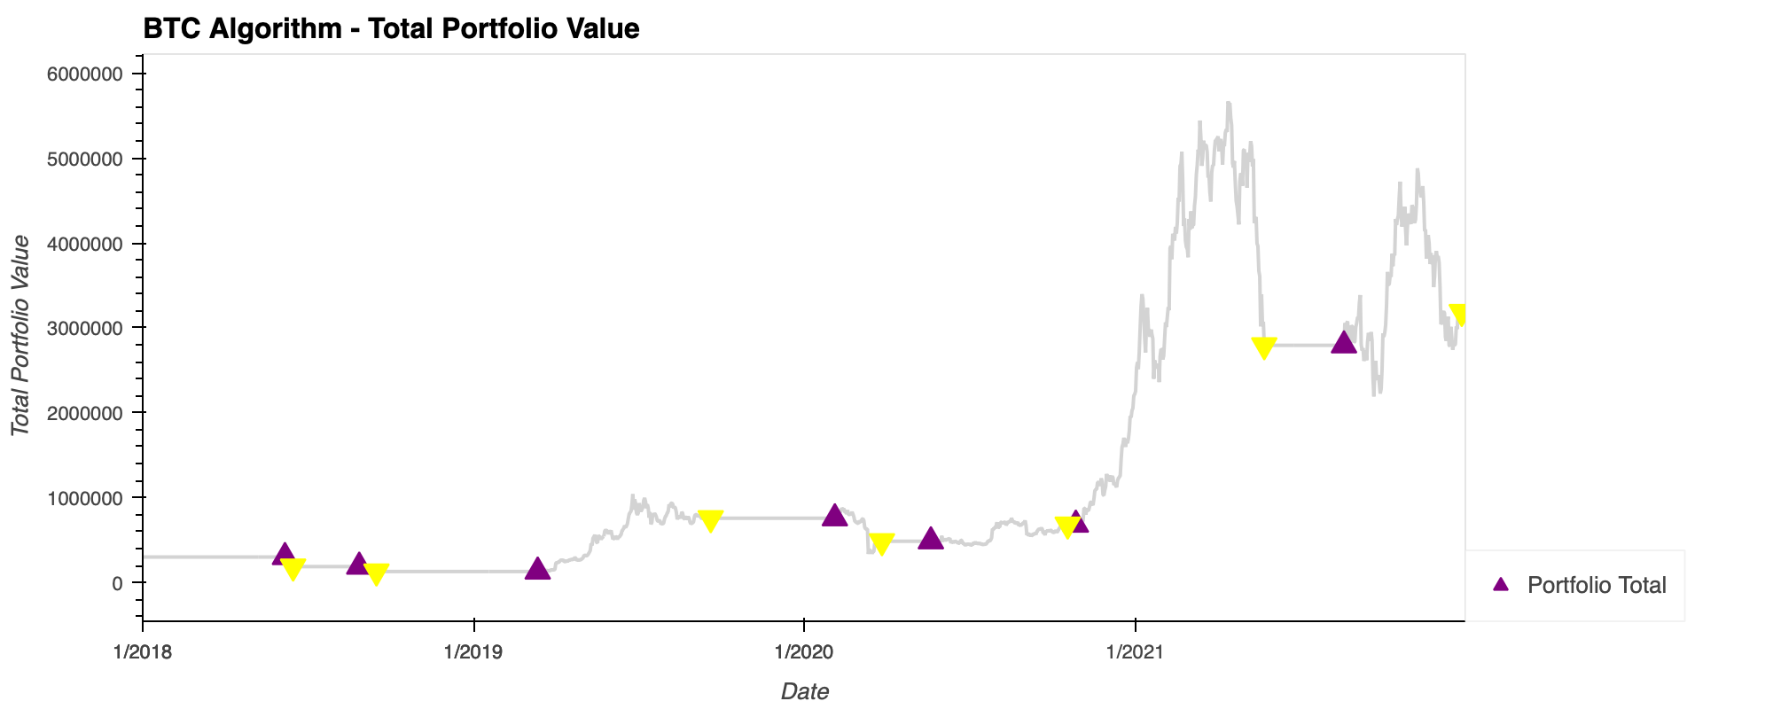
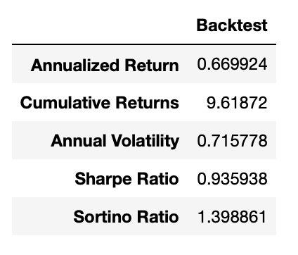
Back testing the Long-Position Algorithm
The annual volatility of the portfolio has a spread of about 71.58% surrounding the annualized return.
The final value of the trading algorithm resulted in a final portfolio value of $3,185,616.11 during the back testing period.
The investor has a medium risk tolerance and a medium time horizon so they can afford to take some risk, my recommendation would be that an investment in BTC needs to be combined with other asset classes for diversification and hedging purposes.

Slide 15
Part 3: Build an algorithmic trading bot to create trading signals for BTC
Define
Define Trading Strategy: When actual returns are greater than or equal to 0, buy stock long but if actual returns are less than 0, sell stock short.
Create
Create trading signals for actual returns and strategy returns.
Use
Use the linear regression to predict the returns and analyze these returns

Slide 16
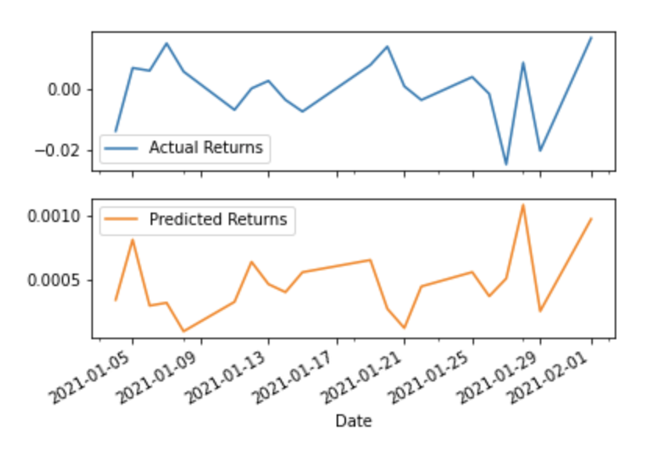
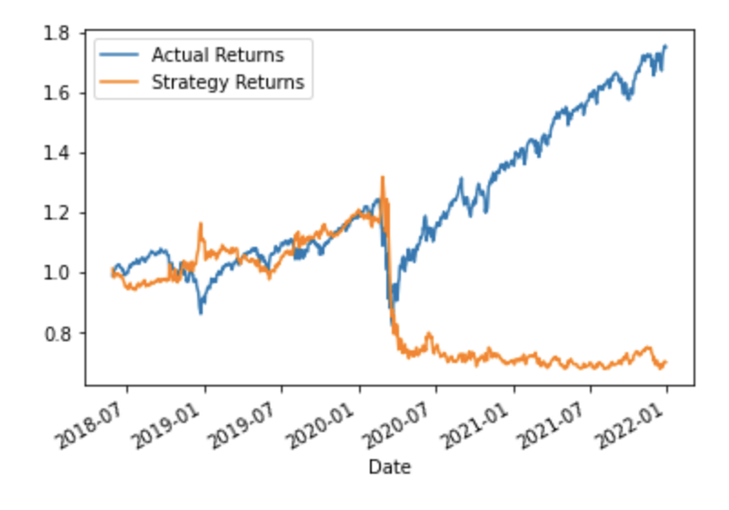
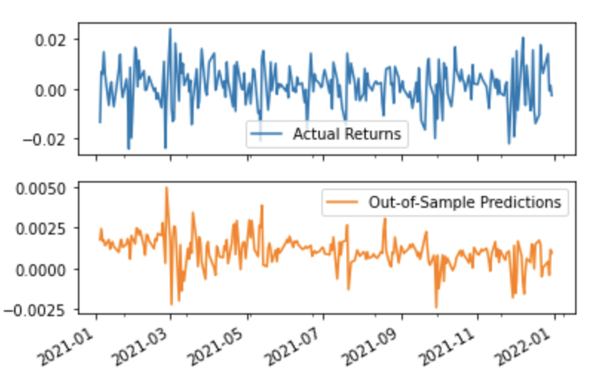
Data Visualization
Actual Returns vs Predicted Returns Plot
Actual Returns vs Strategy Returns Plot
Actual Returns vs Out of Sample Predictions Plot

Slide 17
Conclusion
Out of the three RMSE scores, the out-of-sample RMSE is the lowest with a value of 0.00826. Therefore, it is better to use out-of-sample data that the model hasn't seen before because it gives us a higher accuracy in our predictions. This makes sense if we factor in how BTC's price is constantly fluctuating making it both volatile and unpredictable.
Based on the baseline performance and predicted returns, I would advise the investor to buy BTC because the model shows that the predicted returns vs actual returns are not too different. This is reassuring to an investor who may question if BTC’s actual performance is indicative of future performance.
Overall, the investor is moderately risk tolerant, but BTC is very volatile so while the investor can afford to assume some risk, the portfolio has to include other asset classes for diversification and hedging purposes.

Slide 18

Thank you for your time! Any Questions? ☺

